Slide 1
TIME COMPLEXITY OF SEIVE OF ERATOSTHENES ALGO
Analyzing the time complexity of the above algorithm, for all prime nos Pj<n we cross out a maximum of:
n/2 + n/3 + n/5 + n/7 +…….=n*∑(pj<n)(1/pj)
=n*sum of reciprocals of prime nos <n
If we let S(n) = the sum of the reciprocals of the primes less than n, then for n > 1,
log log n < S(n) < log log n + B + 1/(log n)²
Derived from prime number theorem
So we can say s(n)<log log n
=>ns(n)<n*log logn
=> T(n)=O(nloglogn)
But in the research paper it is given as Ώ(n)
It is also right because s(n)>loglogn
=>n*s(n)>n*loglogn

Slide 2
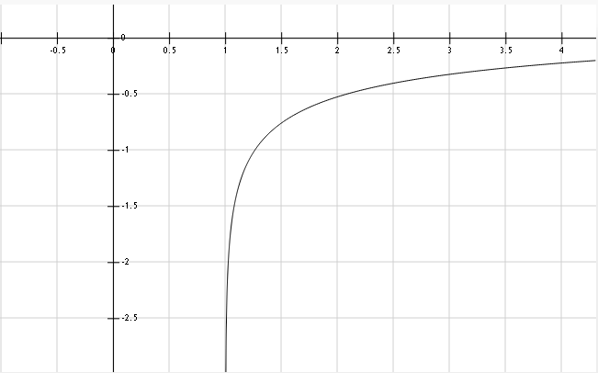
So from graph we get to know that loglogn is always –ve so, ns(n)>=n also
Hence we can prove T(n)= Ώ(n)

Slide 3
EXPLINATION OF-2.BASIC IDEA AND APPROACH
The Identity that was used is “Identity Suppose that a is coprime to p. Then p is prime if and only if (x − a)^p ≡ (x^p − a)(mod p)”
This Identity Is similar to the Fermat’s little theorem a^{p} ≡ a(mod p)
But the problem with it is that it doesn't guarantee that a number P passing the theorem is necessarily Prime but it does so for a Composite number.
BUT the Identity used by AKS will satisfy iff p is prime

Slide 4
Proof of the identity used
Given proof:” For 0 < i < p, the coefficient of x^i in ((x − a)^p − (x^p − a)) is (−1)^i(pCi)(a^(p−i)) Now if p is prime, pCi ≡ 0(mod p) and hence all the coefficients are zero. ”

Slide 5
Proof explanation
Euclid’s Lemma: If a, b, and c are natural numbers and a divides bc, with a and b having no prime factors in common (a and b are relatively prime), then a divides c.
We know that C( p, i) =p( p − 1)( p −2)……..( p −i +1)/i!
But C( p, i) is an integer and denominator i! divides the numerator. Let a = i!, b = p , and c = ( p −1)( p −2) ( p −r +1) in our statement of Euclid’s Lemma. Since i < p all of the prime factors of i! are less than p. Thus p(b) and i!(a) are relatively prime
Here a divides bc and since and a and b are relatively prime so, by Euclid’s Lemma, a divides c

Slide 6
Proof explanation contd…
“If p is composite: consider a prime q that is a factor of p and let q^k||p. Then q^k does not divide pCq and is coprime to a^(p−q) and hence the coefficient of x^q is not zero (mod p). Thus ((x − a)^p − (x^p − a)) is not identically zero over Fp.”
If q is a prime no and is a factor of p and we are taking q^k to be a factor of p.
pCq=p(p-1)(p-2)…….(p-q+1)/q!
=p(p-1)(p-2)…….(p-q+1)/q(q-1)!
Now we can’t divide pCq by q^k since numerator is already being divided by q so can be divided by q^(k-1) only so we can’t divide by q^k
So for the case i=q coeff. Of x^q not equal to zero(mod p)
So the used identity is correct

Slide 7
IMPROVED EFFICIENCY…
“Thus given a p as input, one could pick a polynomial P (x) = x−a and compute whether the congruence(1) is satisfied or not. However, this takes time Ω(p) because we need to evaluate p coefficients in the LHS in the worst case. Therefore, to make it feasible we will evaluate both sides of (1) modulo a polynomial of the form xr − 1. One iteration of our algorithm will consist of evaluating whether the following holds:
(x − a)^p ≡ (x^p − a)(mod (x^r) − 1, p) (2) “

Slide 8
EXPLANATIONS
The first relation(1) is certainly a valid primality test, it is horribly inefficient as it involves the computation of n coefficients. The trick however is in choosing a suitable integer a. The simplest method for reducing the number of coefficients that need to be computed is to evaluate f(x) modulo n and modulo some polynomial of small degree, say (x^{r} - 1).
(x − a)^p ≡ (x^p − a)(mod (x^r) − 1, p)
which is the same as:(x-a)^{p}-(x^{p} - a)= pf+(x^{r}-1)g,for some polynomials f and g.
It is clear that all primes p satisfy (x + a)^{p} - (x^{p} + a) ≡ 0 mod (p, x^{r} -1), some composite numbers may satisfy this equation for all values of a and r.

Slide 9
Explanation Contd..
It turns out that for a judiciously chosen r, if the above identity is satisfied for several values of a, then n can be shown to be a prime power. The number of a's and the appropriate value of r are bounded by log(n).(It is provable-(using FOURIER MULTIPLICATION) that r need only be logarithmic with respect to n.)
The congruence can be checked in polynomial time with respect to the number of digits in n, because It is provable that r need only be logarithmic with respect to n. The proof of correctness for AKS consists of showing that there exists a suitably small r and suitably small set of integers A such that, if the congruence holds for all such a in A, then n must be prime.

Slide 10
SUITABLE r-value
Our algorithm first chooses a “suitable” r. (An r is “suitable” for us if it is a prime =O (log^6 (p)) and r − 1 contains a prime factor of size at least r ^(1/2 +δ), for some constant δ > 0. [Fou85, BH96] assures us that such a “suitable” r exists.) Thereafter, the algorithm verifies the congruence (2) for a “small” ( O (√r log p) ) number of a’s. We prove that this idea works: i.e. The algorithm correctly determines whether p is prime or not.

Slide 11
EXPLANATION
From the above statements we understand that according to AKS “suitable” r should be a prime such that it is within the bound of O(log^6(p)) and r-1 should have prime factor which are >= r^(0.5+δ) and after finding such an r we can check the congruence-2 for O (√r log p) no. of a’s , which is considered to be a small number.
They have specifically chosen r^(0.5) because an inefficient primality test could also be done by checking for divisibility by each number from 2 t to sqrt(n) so we are choosing an prime greater that sqrt(n)

Slide 12
BASICS AND PRELIMINARIES
“In the rest of the paper Fpd denotes the finite field, where p is a prime. Recall that if p is a prime and h(x) is a polynomial of degree d and irreducible in Fp, then Fp[x]/(h(x)) is a finite field of order pd. In the rest of the paper h(x) will be a factor of x^r −1 unless stated otherwise. x−1
We will use the symbol O˜ (t(n)) for O (t(n)poly(log t(n))), where t(n) is some function of n. Unless stated otherwise, log will be to base 2 in this paper.
We now collect some simple facts from algebra that can be found in any standard text, e.g. [LN86, Fra90]. We also prove some of these for the sake of completeness.”

Slide 13
BASIC CONCEPTS EXPLANATION
RESIDUE: b is the residue in case of a≡b(mod n)
RESIDUE CLASSES: The residue classes of a function f(x)(mod n) are the set of all possible values of the residue of f(x)(mod n) where x ɛ (0,n-1)
A finite field is a field with a finite field order (i.e., number of elements). The order of a finite field is always a prime or a power of a prime. For each prime power, there exists exactly one finite field GF(p^n), often written as in current usage as Fp^n.
GF(p) is called the prime field of order p, and is the field of residue classes modulo , where the elements are denoted 0, 1, ...p-1, . a=b in GF(p) means the same as a≡b(mod p)

Slide 14
BASICS EXPLANATION CONTD…
A polynomial is said to be irreducible if it cannot be factored into nontrivial polynomials over the same field.
For example, in the field of rational polynomials Q(x) (i.e., polynomials f(x) with rational coefficients), is said to be irreducible if there do not exist two non-constant polynomials g(x),h(x) and in with rational coefficients such that : f(x)=g(x)h(x)

Slide 15
BASICS EXPLANATION CONTD…
AKS have taken h(x) will be a factor of x^r −1 unless stated otherwise. x-1 Which means h(x) is a factor of a G.P with 1st term 1 and common factor x:
1+x+x^2+x^3+.......+x^r

